Slide 1
BBM 382 – SOFTWARE ENGINEERING
SPRING 2018
Lecture 4
Asst.Prof.Dr. Ayça TARHAN

Slide 2
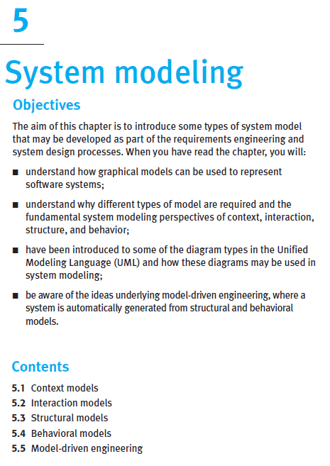
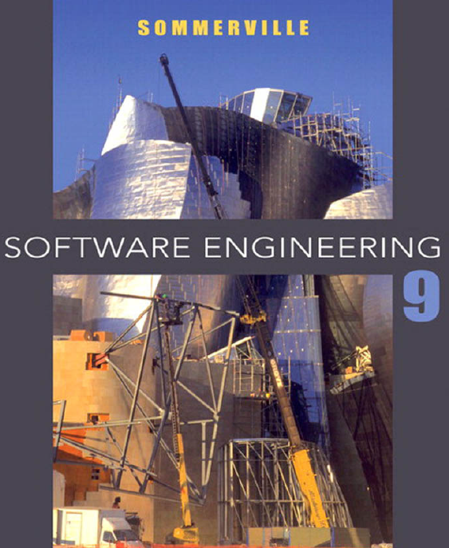
From the book
Read it online!

Slide 3
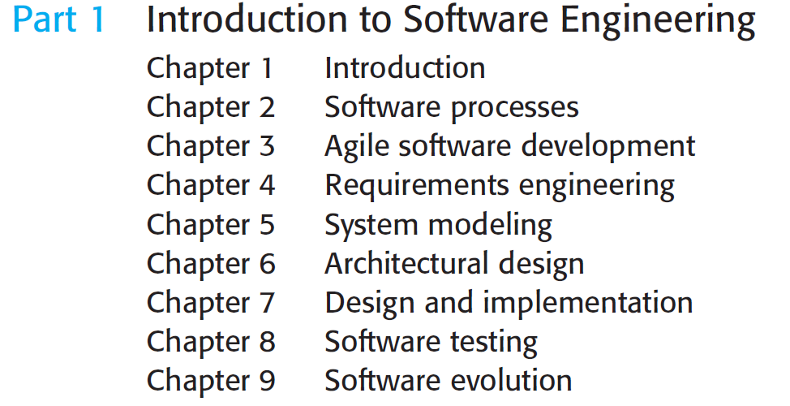
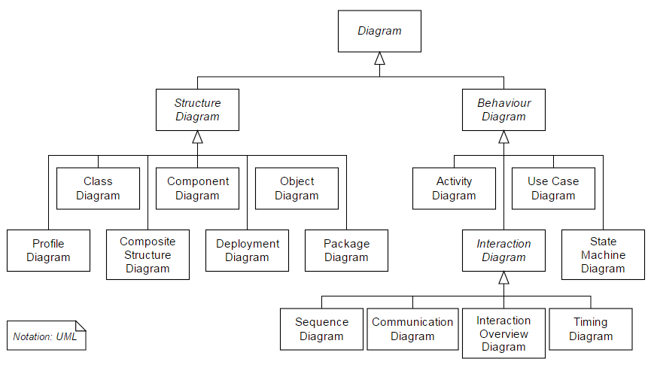
UML
14 diagrams in total
Ch. 5
Ch. 5
Ch. 4
Ch. 4, 6
Ch. 6
Ch. 4, 6
Ch. 5
Ch. 4

Slide 4
Unified Modeling Language - UML
UML has become the de facto standard for modeling software applications and is growing in popularity in modeling other domains. Its roots go back to three distinct methods:
Booch Method -- Grady Booch
Object Modeling Technique -- James Rumbaugh
Objectory -- Ivar Jacobson
Known as the Three Amigos, Booch, Rumbaugh, and Jacobson kicked off what became the first version of UML, in 1994.
In 1997, UML was accepted by the Object Management Group (OMG) & released as UML v1.1.
Since then, UML has gone through several revisions and refinements leading up to the current 2.5.1 (2017) release.
https://www.omg.org/spec/UML/About-UML/
Specification is extensive in terms of page count (796 pages)

Slide 5
UML Basics – 1
UML is a language, it has both syntax and semantics.
When you model a concept in UML, there are rules regarding how the elements can be put together and what it means when they are organized in a certain way.
UML is intended not only to be a pictorial representation of a concept, but also to tell you something about its context.
You can apply UML in any number of ways; common uses include:
Designing software
Communicating software or business processes
Capturing details about a system for requirements or analysis
Documenting an existing system, process, or organization

Slide 6
UML Basics – 2
The basic building block of UML is a diagram.
A diagram graphically represents things, and the relationships between these things.
These things can be representations of real-world objects, pure software constructs, or a description of the behavior of some other object.

Slide 7
UML Rules of Thumb
Nearly everything in UML is optional
UML provides a language to capture information that varies greatly depending on the domain of the problem, and you don't need to use every part of UML in every model you create.
At times there is more than one way to convey the same information; use what is familiar to your audience.
UML models are rarely complete
As a consequence of everything being optional, it is common for a UML model to be missing some details about a system. The trick is to not miss key details that could impact your system design.
As UML moves closer to tool automation with practices like MDA, the models often become more and more detailed and therefore complete.
UML is designed to be open to interpretation
While the UML specification does a good job of laying down the groundwork for a modeling language, it is critical that within an organization or group of users you establish how and when to use a language feature.
E.g. an aggregation relationship to indicate a C++ pointer and a composition relationship to indicate a C++ reference.
It is a good practice to put together a document on modeling guidelines.
UML is intended to be extended
UML includes several mechanisms to allow customization and refinement of the language (e.g. adornments, constraints, and stereotypes ). Typically these are grouped into what are known as UML profiles.
E.g. a Java 2 Enterprise Edition (J2EE) profile that includes stereotypes for sessionbean or javadataobject.

Slide 8
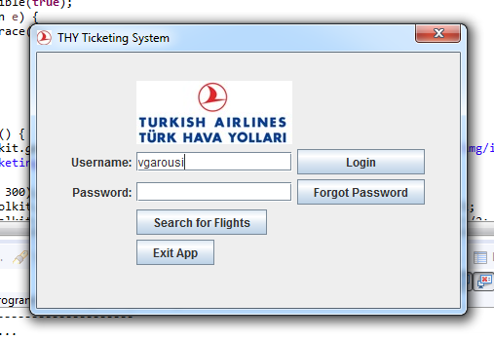
Flight Booking System (FBS)
(see "FBS User Requirements and Use-case Modeling.pdf")
A Flight Booking System (FBS) that serves different functionalities for reservation agents and reservation managers shall be designed and developed.

Slide 9
FBS – Use-Case Diagram

Slide 10
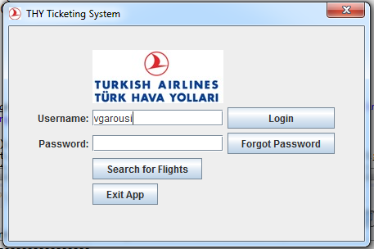
Tabular description of use-cases
Use case: Login
Actors | Traveler
Precondition | Traveler is not logged in
Post-condition | Traveler is logged in
Main (happy) path: | User enters her/his username and password and presses on the Login button System checks the username and password and shows the app’s main window (page) User will be able to use the feature afterwards
Alternative path: | If the username and password combination is invalid, the system will show a message indicating it User will be able to enter another username and password

Slide 11

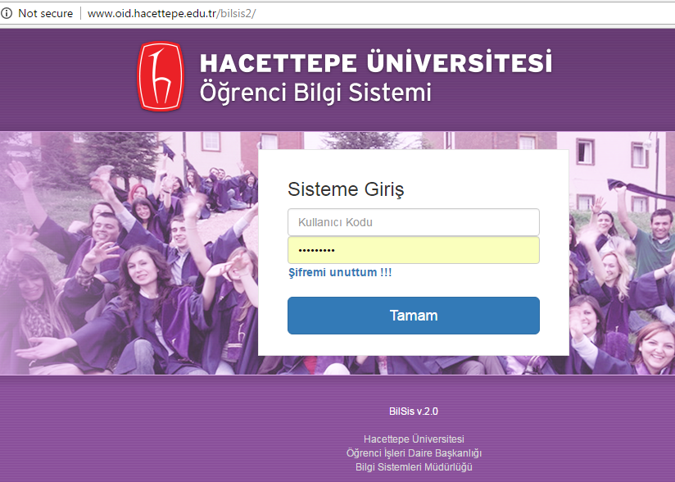
Exercise
System: student information system (like BILBSIS2)
Design:
The context diagram
The use-case diagram
Three tabular descriptions for three use-cases
Three activity diagrams for three other use-cases

Slide 12
For student reading

Slide 13
System modeling
System modeling is the process of developing abstract models of a system, with each model presenting a different view or perspective of that system.
System modeling has now come to mean representing a system using some kind of graphical notation, which is now almost always based on notations in the Unified Modeling Language (UML).
System modelling helps the analyst to understand the functionality of the system and models are used to communicate with customers.

Slide 14
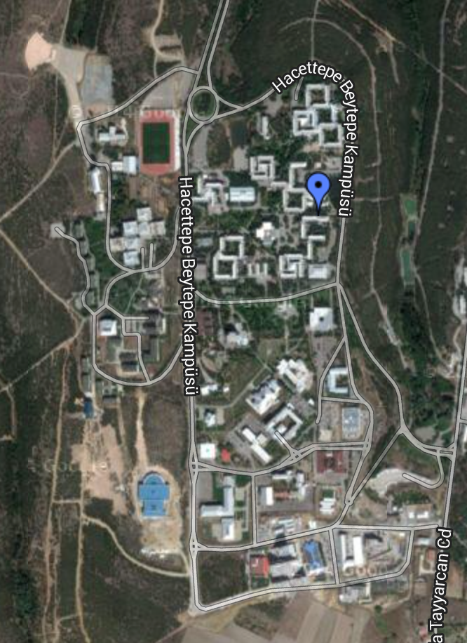
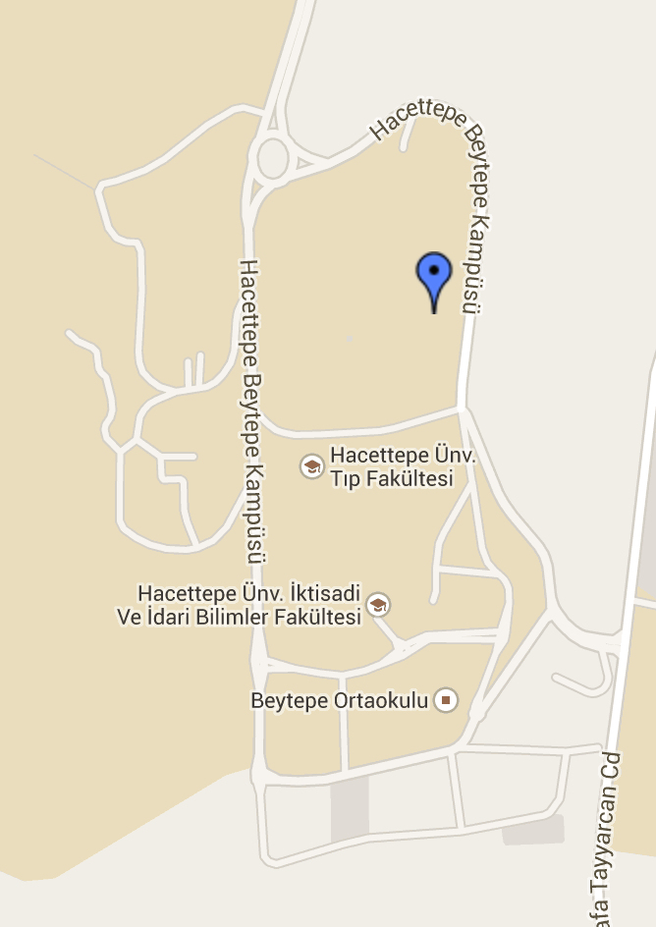
Real vs. Model – Beytepe Kampüsü
Real – Satellite View
Model – Vector Map

Slide 15
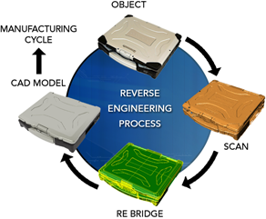
Existing and planned system models
Models of the existing system are used during requirements engineering, re-engineering and reverse-engineering .
They help analyst clarify what existing system does and can be used as a basis for discussing its strengths and weaknesses. These then lead to requirements for the new system.
Re-engineering: Systematic starting over and reinventing the way a firm, a software, or a business process, work (code refactoring in our context)
Reverse engineering: taking apart an object to see how it works in order to duplicate or enhance the object. The practice, taken from older industries, is now frequently used on computer hardware and software.
Re-engineering ≠ Reverse engineering

Slide 16
Existing and planned system models
Models of the new system are used during requirements engineering to help explain proposed requirements to other system stakeholders.
Engineers use these models to discuss design proposals and to document system for implementation.
In a model-driven engineering process, it is possible to generate a complete or partial system implementation from system model.

Slide 17
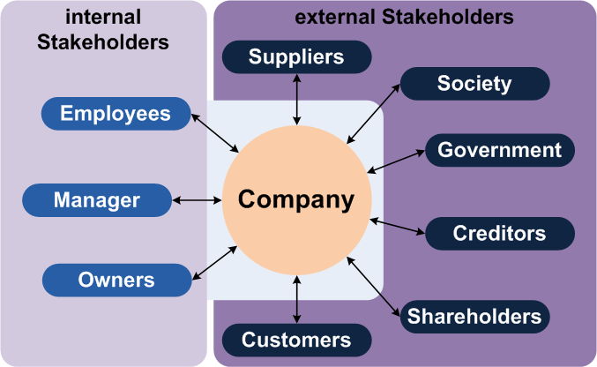
Stakeholders of a Company
http://upload.wikimedia.org/wikipedia/commons/4/4c/Stakeholder_%28en%29.png
Notes:
stake·hold·er (noun) 1. somebody or something with direct interest

Slide 18
System perspectives
An external perspective, where you model context or environment of the system.
An interaction perspective, where you model interactions between a system and its users and/or environment, or between components of a system.
A structural perspective, where you model organization of a system or structure of data that is processed by system.
A behavioral perspective, where you model dynamic behavior of system and how it responds to events.

Slide 19
Contents
5.1 Context models
5.2 Interaction models
5.2.1 Use-case models + Activity models
5.2.2 Sequence diagrams
5.3 Structural models
5.4 Behavioral models
5.5 Model-driven engineering

Slide 20
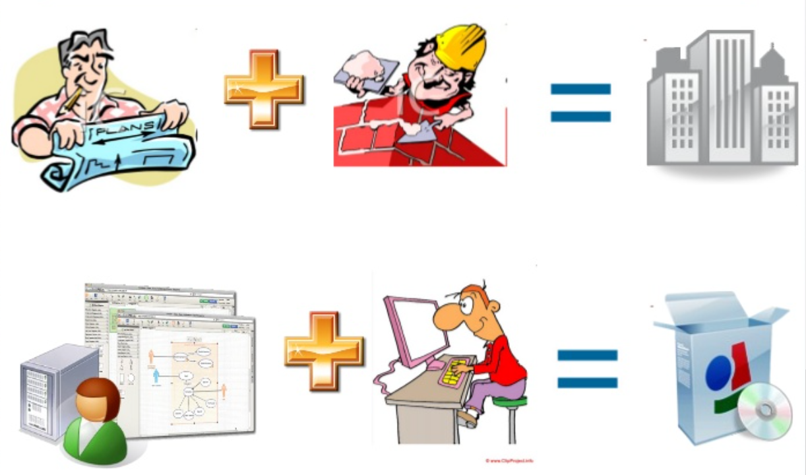
System modeling metaphore
http://www.slideshare.net/jcabot/mde-20-pragmatic-model-verification-and-other-stories-habilitation-public-lecture
Notes:
http://www.slideshare.net/jcabot/mde-20-pragmatic-model-verification-and-other-stories-habilitation-public-lecture

Slide 21
FBS – User Requirements (READ LATER)
The system shall be a simple, stand-alone application.
“Stand-alone” means that it shall not be developed as a web-based on-line application, but a one which runs as an application on a single computer.
A reservation manager shall be able to use the system to create accounts for reservation agents. The system shall enable a reservation manager to log in with his/her username and password. The reservation manager shall be able to manipulate flights (enter new ones, update existing flight information, delete flights, etc.), and generate inventory reports of flights. When a flight is canceled by the reservation manager, all itineraries that are reserved or booked and include that flight shall be canceled as well. The reservation manager shall be able to view information of a reservation agent and confirm a ticket for him/her. The reservation manager shall be able to log out at any stage during his/her session.

Slide 22
FBS – User Requirements (..cont’d)
A reservation agent (traveler) shall be able to buy a ticket by using the system. An agent shall be able to register himself/herself with the reservation site by entering personal profile information. The system shall enable a reservation agent to log in with his/her username and password. Once the agent is logged in, he/she shall be shown with a list of travel itineraries along with the status of each itinerary (reserved, booked, confirmed, or canceled). A travel itinerary is a travel arrangement with one or more flights, e.g., an example travel itinerary might consist of the following three flights: Calgary-Vancouver, Vancouver-Los Angeles and Los Angeles-New York. The reservation agent shall create a reservation and pay for it to book the flight. The agent shall cancel a previously created reservation in his/her itinerary list, but the cancellation of an itinerary cannot be rolled back.

Slide 23
FBS – User Requirements (..cont’d)
When a reservation agent wants to create and book a travel itinerary, he/she first shall search for flight information. A list of available flight options shall be shown with departure/arrival and cost information. Once the agent selected an itinerary from the list, he/she shall have the option to reserve it. Once the reservation agent reserved an itinerary, he/she shall have the option to book it by providing payment information via credit card. If the credit card information is not on-file for the agent, he/she shall be prompted to enter the credit card information.

Slide 24
FBS – User Requirements (..cont’d)
Once the credit card is validated, the reservation agent shall be shown with the actual ticket information. The ticket number shall be unique for each agent in each flight. If the credit card number is invalid, an error message shall be displayed to the agent and the agent shall be asked to re-enter the credit card information or cancel the booking process. If a reserved itinerary is not paid for by 5 minutes from the time of reservation, it cannot be booked anymore and it shall be canceled by the system. Cancellation after payment shall not be permitted. The reservation agent shall be able to log out at any stage during his/her session. If the agent is logged out during the preparation of an itinerary, the next time when he/she is logged in again, the reservation agent shall be able to continue with the previous itinerary-preparation process.

Slide 25
FBS – Context Diagram

Slide 26
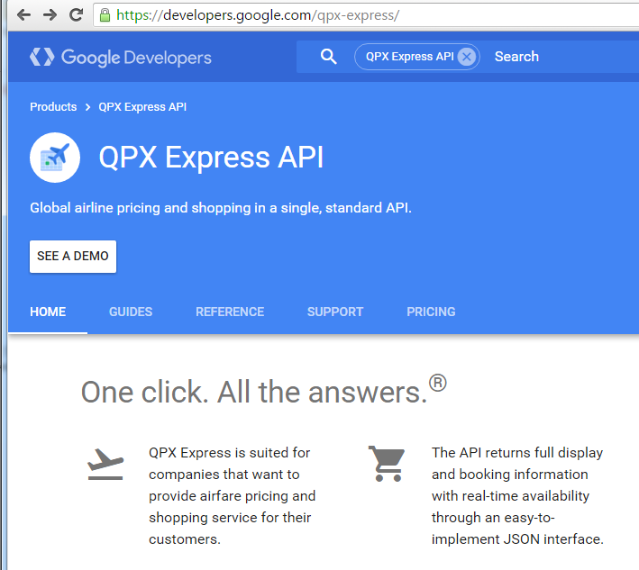
Context diagram of FlightBooking System
Example of APIs…

Slide 27
UML
14 diagrams in total

Slide 28
In-class exercise
Write the tabular description of use-case “View My Tickets”
Time: 5 minutes

Slide 29
FBS – Details of "Search for Flights" use-case desc. by Activity Diagram

Slide 30
FBS – Details of "Buy a Ticket" use-case description by Activity Diagram

Slide 31
In-class exercise
Draw the Activity Diagram for use-case “Create Account”
Time: 5 minutes

